Slide 1
Learning intentions and success criteria
I am learning…
I can…
About the design stage of software development
How to read and create structure diagrams
Describe the design phase and the aspects of software analysis
Design structure diagrams according to a program specification

Slide 2

Design
N5 - Software Design & Development

Slide 3

Design Techniques
At National 5, you will need to know how to explain and implement three design techniques:
Design of the User Interface (Wireframe)
Design of the structure of the software (Structure Diagram)
Design of the detailed logic of the software (Flowchart)
You will also need to read, understand, and write Pseudocode.

Slide 4
Structure Diagram
Structure diagrams are a visual design technique used to show the steps needed to solve a problem.
When reading a structure diagram start at the top and work towards the bottom.
If a level contains more than one branch, read from left to right before moving to the next level.

Slide 5
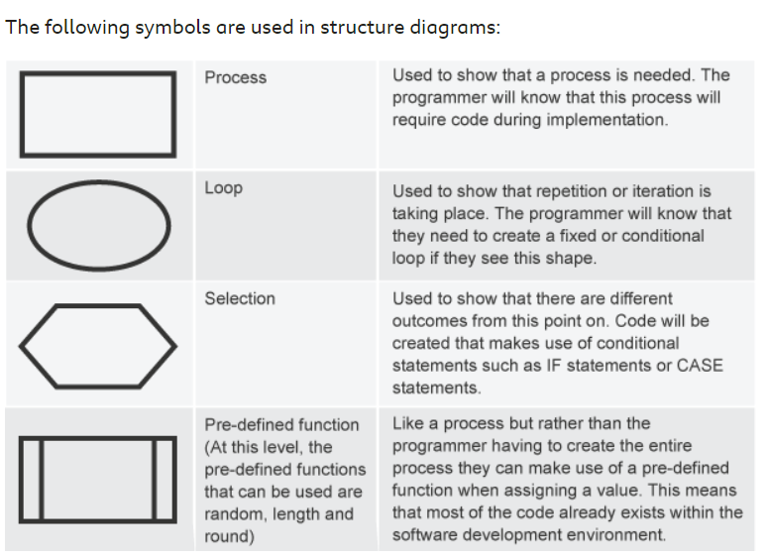
Structure Diagram
The following symbols are used in structure diagrams:

Slide 6
Basic Worked Example
A program which asks the user for a temperature in Celsius, converts it to Fahrenheit, and displays the converted temperature to the user.
First, identify the Inputs, Processes, and Outputs
Get temperature in Celsius from user (input)
Convert the Celsius temperature to Fahrenheit (process)
Display the temperature in Fahrenheit to the user (output)

Slide 7
Basic Worked Example
A program which asks the user for a temperature in Celsius, converts it to Fahrenheit, and displays the converted temperature to the user.
Temperature Converter
Get temperature in Celsius
Convert Celsius to Fahrenheit
Display temperature in Fahrenheit

Slide 8
tasks
Identify the Inputs, Processes, and Outputs, then design the following programs using structure diagrams:
A maths program which takes the length and height of a rectangle, calculates the area, then display the result to the user
A booking program which asks for the number of guests and number of nights, calculates the total booking cost and returns the total to the user.
A restaurant program which takes the initial total, then asks for a tip percentage (e.g. 10%). It should then calculate the final cost and display it to the user.

Slide 9
Worked Example with Condition
A program for an English teacher to enter the last 3 essay scores for a pupil, calculate the average and then display the pass/fail result.
If the average is over 40, then student will achieve a pass for this work.
Get last 3 essay results (input)
Calculate the average result (process)
If average is over 40, student passes, otherwise they fail (process)
Display the pass/fail result to the user (output)

Slide 10
Worked Example with Condition
A program for an English teacher to enter the last 3 essay scores for a pupil, calculate the average and then display the pass/fail result.
If the average is over 40, then student will achieve a pass for this work.
Essay Marking
Get essay scores
Calculate average score
If average score greater than 40
Yes
No
Display pass message
Display fail message

Slide 11
tasks
Identify the Inputs, Processes, and Outputs, then design the following programs using structure diagrams:
A login program where the user enters their username and password. If the password is “MrWang4Eva” then display “Welcome back”, otherwise display “Incorrect” to the user
A program which asks the user how old they are. If the age is 17 or more, display “You can learn to drive”, otherwise display “You cannot drive yet”.
A program that takes a user’s bank balance and the price of a pair of shoes. Display a message saying whether the user can afford to buy the shoes or not.

Slide 12
Worked Example with Loop
A program for a nursery class that will help with their counting.
It will ask the pupil to type their name and then type the number of times it is to be repeated.
The name will then be displayed that number of times.
Counting Program
Get name
Get number of times to repeat
Repeat number of times entered
Display name

Slide 13
tasks
Identify the Inputs, Processes, and Outputs, then design the following programs using structure diagrams:
A program which counts down from a number. The user enters a number to count down from, then the program loops, starting from the user’s number and displaying it, until it reaches zero.
A program which asks the user to enter a number, then loops, displaying a times table for that number up to times 12.

Slide 14
Learning intentions and success criteria
I am learning…
I can…
About the design stage of software development
How to read and create structure diagrams
Describe the design phase and the aspects of software analysis
Design structure diagrams according to a program specification

